Slide 1
Units I and II Test Review
For practice questions and flashcards see the text website.
The course website has a concept map with audio files

Slide 2
Format
Questions were drawn from the key terms on pages 26 and 71 and the ORANGE HAND OUT STUDY GUIDE
45 multiple choice (one point each)
1 essay on perspectives: applying them to a situation
1 essay on research: identifying the type of study and analyzing the results

Slide 3

Unit I test material

Slide 4

Wilhelm Wundt, page 3
Method called Introspection (reflecting on one’s own thoughts)
First psych lab, 1879
Field of psych called Structuralism
He studied the reactions of people to sensory stimuli

Slide 5
Exploring the mind
Wundt’s approach of breaking the mind down into elementary units became less popular.
It was unreliable
It was too subjective, based on opinion
Memories fail
Self reports are often inaccurate
His approach did lead to the modern study of sensation and perception

Slide 6
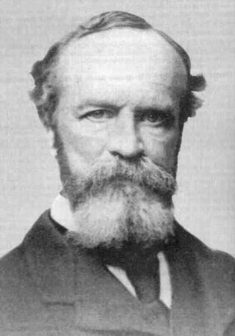
William James, pp. 4-5
Wrote most famous psych text: Principles of Psychology, 1890
Field of psych called Functionalism
He believed you should study how the mind functioned in a situation; how it adapted to conscious thoughts and emotions

Slide 7
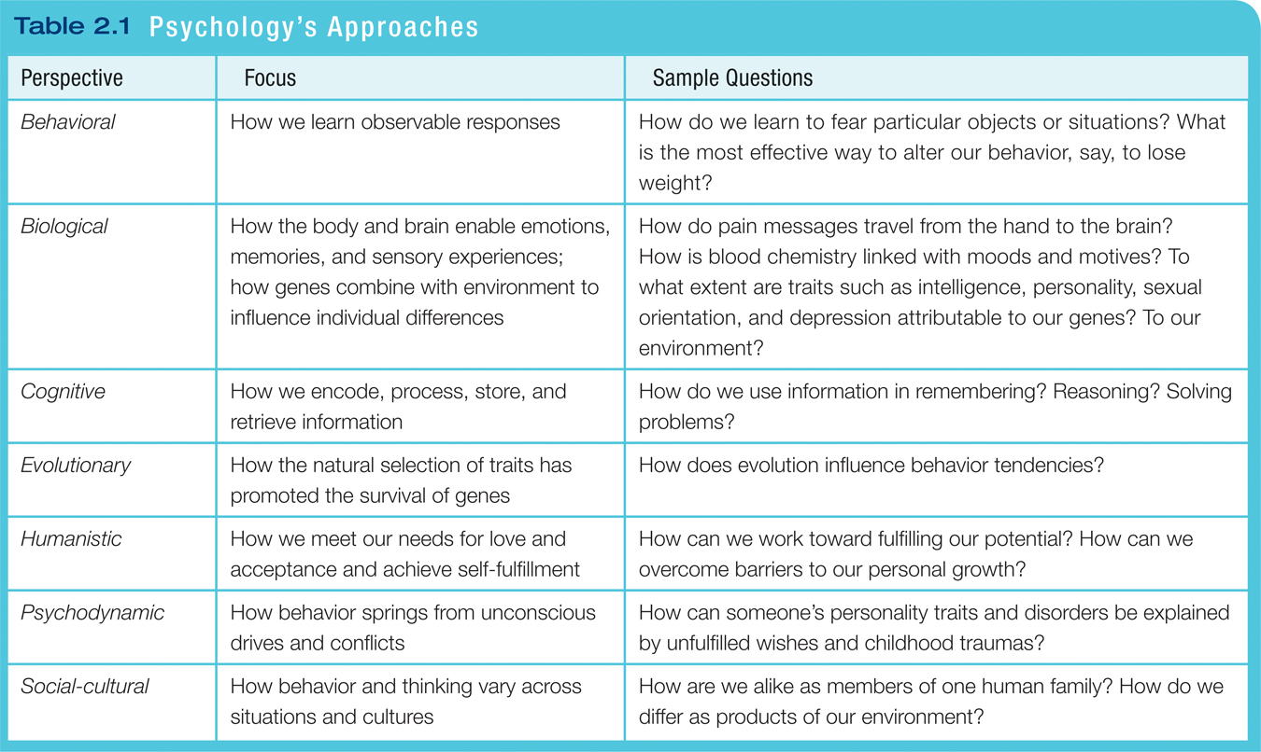
Table 2.1 Psychology’s Approaches
David G. Myers: Myers’ Psychology for AP®, Second Edition
Copyright © 2014 by Worth Publishers

Slide 8
1. Which of the following perspectives is interested mainly in the study of mental processes?
A. psychodynamic
B. humanistic
C. behaviorism
D. evolutionary
E. cognitive

Slide 9
2. Introspection was Wilhelm Wundt’s process of:
A. reflecting on one’s own sensations and feelings
B. spacing our your practice
C. using gestalt psychology
D. clinically examining a patient
E. promoting personal growth

Slide 10
3. Which perspective focuses on the observation of what people do?
A. psychodynamic
B. behavioral
C. humanistic
D. evolutionary
E. biological

Slide 11
4. Which perspective would be best for studying how people from different countries express anger?
A. socio cultural
B. functionalist
C. humanism
D. behavioral
E. psychodynamic

Slide 12
5. Love, acceptance and personal growth would be the focus of which perspective?
A. social cultural
B. functionalist
C. humanism
D. behavioral
E. psychodynamic

Slide 13
Practice answers
1 e 2 a 3 b 4a 5c

Slide 14
Unit II test material

Slide 15
Hindsight Bias, 31
Hindsight Bias is the “I-knew-it-all-along” phenomenon.
After learning the outcome of an event, many people believe they could have predicted that very outcome. We only knew the dot.com stocks would plummet after they actually did plummet.
Notes:
OBJECTIVE 1| Describe hindsight bias and explain how it can make research findings seem like mere common sense.
“Anything seems commonplace, once explained.” Dr. Watson to Sherlock Holmes.
Two phenomena – hindsight bias and judgmental overconfidence – illustrate why we cannot rely solely on intuition and common sense.

Slide 16
Operational definition, 39
  A statement of procedures (operations) used to define research variables
  Example-
    intelligence may be operationally defined as what an intelligence test measures

Slide 17
Replication, 39
  repeating the essence of a research study to see whether the basic finding generalizes to other subjects and circumstances
  usually with different subjects in different situations
  Example:
Joseph Cesario tried to replicate John Bargh’s ‘Do you feel lonely in the shower study?’ Using 2,400 more subjects than Bargh he found no relationship between bathing and loneliness.
Said Cesario: "Extremely small samples, extremely large effects—that's a red flag," he says. "It's not a red flag for people publishing those studies, but it should be.“
http://chronicle.com/article/Power-of-Suggestion/136907/

Slide 18
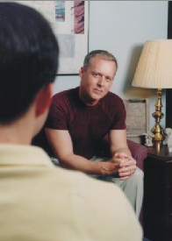
Case Study, 40
Clinical Study
A clinical study is a form of case study in which the therapist investigates the problems associated with a client.
http://behavioralhealth.typepad.com

Slide 19
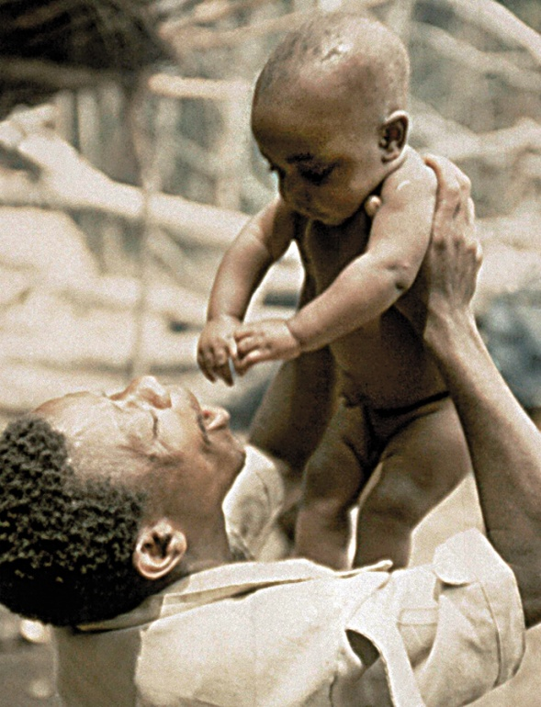
Naturalistic Observation, 40
Observing and recording the behavior of animals in the wild and recording self-seating patterns in a multiracial school lunchroom are examples naturalistic observation.
Courtesy of Gilda Morelli
Notes:
OBJECTIVE 7| Identify the advantages and disadvantages of naturalistic observation in studying behavior and mental processes.

Slide 20
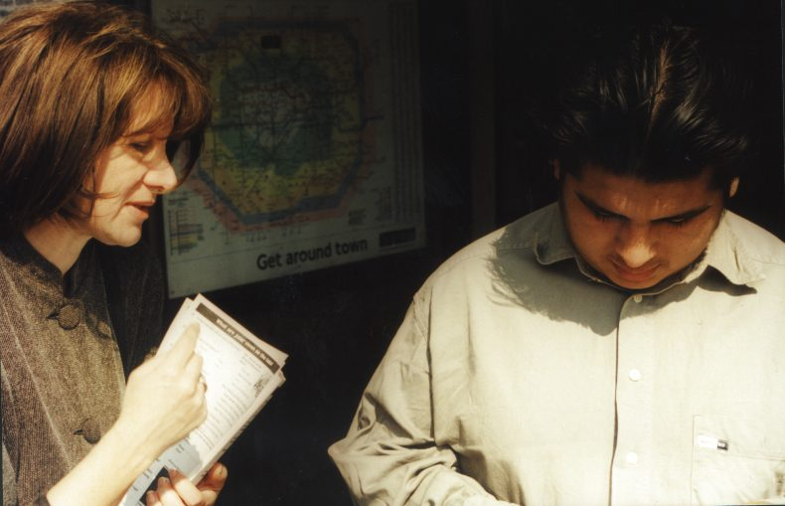
Survey, 42
A technique for ascertaining the self-reported attitudes, opinions or behaviors of people usually done by questioning a representative, random sample of people.
http://www.lynnefeatherstone.org
Notes:
OBJECTIVE 6| Identify the advantages and disadvantages of surveys in studying behavior and mental processes, and explain the importance of wording effects and random sampling.

Slide 21
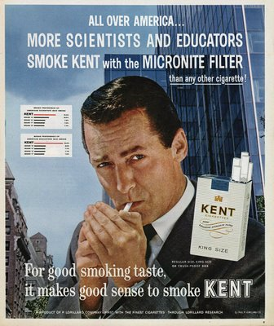
Wording Effects, 42
Wording can change the results of a survey.
Q: Should cigarette ads be allowed on television? (not allowed vs. forbidden)

Slide 22
Sampling the Population, 43
Population
  all the cases in a group, from which samples may be drawn for a study
Random Sample
  a sample that fairly represents a population because each member has an equal chance of inclusion

Slide 23
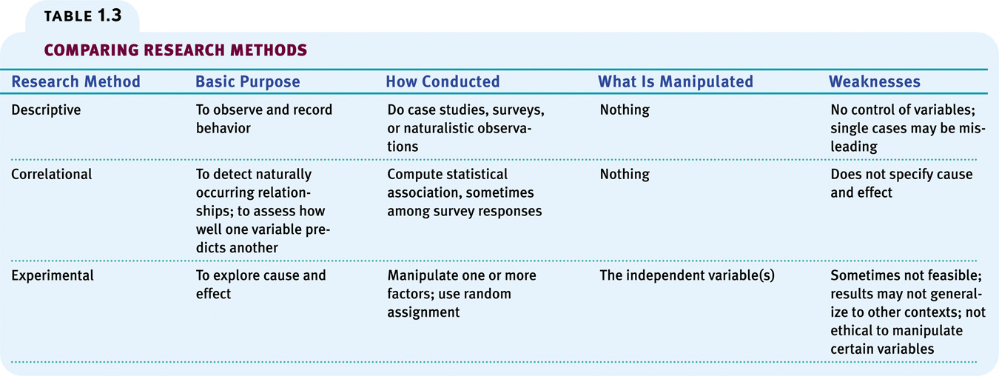
Comparison
Below is a comparison of different research methods.

Slide 24
Practice question 5: Why is an operational definition of variables necessary?
A. it is better than the dictionary
B. it uses scientific language
C. you can translate the information into other languages
D. it provides more context for the reader
E. it allows other researchers to replicate the procedures used by the first experimenter

Slide 25
6 You need to watch elementary students on the play ground to study play habits for your psychology class. What method are you using?
A. case study
B. district study
C. random sample approach
D. naturalistic observation
E. survey

Slide 26
7: Bob is a supermemorist, able to recall every aspect of all of his birthdays back to age five. You give him questionnaires, a brain scan and some tests. What method are you using?
A. observation
B. case study
C. interview
D. survey
E. experimentation

Slide 27
answers
5e
6d
7b

Slide 28
Correlation coefficient, 46
  a statistical measure of the extent to which two factors vary together and thus how well either factor predicts the other
Indicates direction
of relationship
(positive or negative)
Correlation
coefficient
r = +.37
Indicates strength
of relationship
(0.00 to 1.00)

Slide 29
Scatterplots, 47
Perfect positive
correlation (+1.00)
Scatterplot is a graph comprised of points that are generated by values of two variables. The slope of the points depicts the direction, while the amount of scatter depicts the strength of the relationship.

Slide 30
Correlations by scatterplot, 47
Perfect positive
correlation (+1.00)
No relationship (0.00)
Perfect negative
correlation (-1.00)

Slide 31
Correlation doesn’t equal causation
Just because two variables are correlated doesn't mean one causes the other.
The classic example is the case where the number of churches and crime rate both increased. How could that be?
A third variable: population increase.
Or the greater the ice cream the greater the deaths by drowning.
Both could be due to a third variable: more population.

Slide 32
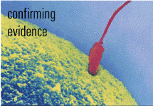
Illusory Correlation, 50
  the perception of a relationship where none exists
Conceive
Do not conceive
confirming
evidence
disconfirming
evidence
Adopt
disconfirming
evidence
confirming
evidence
Do not
adopt

Slide 33
Experimentation, 50
Exploring Cause and Effect
Like other sciences, experimentation is the backbone of psychology research.
Experiments isolate causes and their effects.
Notes:
OBJECTIVE 12| Explain how experiments help researchers isolate cause and effect.

Slide 34
Random Assignment, 51
Assigning participants to experimental and control conditions by random assignment minimizes pre-existing differences between the two groups.
Notes:
Sometime research participants out of enthusiasm or personal beliefs can affect the out come of an experiment. To control for such affects, a double-blind procedure is used, in which the participants and the experimenter’s assistants are not aware of which participants got real treatment and who got placebo.

Slide 35
Double blind procedure, 51
  both the subject and the research staff are ignorant (blind) about whether the subject has received the treatment or a placebo
  commonly used in drug-evaluation studies

Slide 36
Placebo, 52
  an inert substance or condition that may be administered instead of a presumed active agent, such as a drug, to see if it triggers the effects believed to characterize the active agent

Slide 37
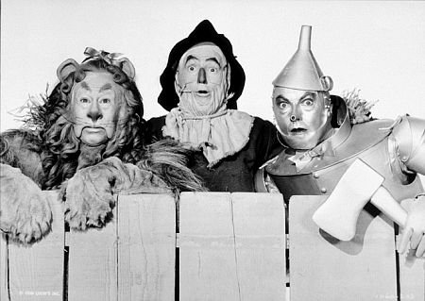
Placebo effect
The tin man didn’t really receive a heart, the lion didn’t really get courage and the scarecrow didn’t really obtain a brain.
But they felt that they did.

Slide 38
Conditions (groups), 51
Experimental Condition
  the condition of an experiment that exposes subjects to the treatment, that is, to one version of the independent variable
Control Condition
  the condition of an experiment that contrasts with the experimental treatment
  serves as a comparison for evaluating the effect of the treatment

Slide 39
Independent Variable, 52
The independent Variable is a factor manipulated by the experimenter.
The effect of the independent variable is the focus of the study.
Notes:
OBJECTIVE 14| Explain the difference between an independent variable and a dependent variable.

Slide 40
Dependent Variable, 52
A dependent Variable is a factor that may change in response to an independent variable.
In psychology, it is usually a behavior or a mental process.

Slide 41
Confounding Variable, 52
In an experiment, a variable other than the independent variable that could produce a change in the dependent variable
The variable “confounds” the results

Slide 42
Typical human confounders
Age
Gender
Smoking
Income
RANDOM ASSIGNMENT CAN CONTROL FOR MOST OF THESE CONFOUNDERS.
This means the differences are spread out among the two groups, so these factors aren’t the major cause of any differences in the study

Slide 43
Practice question 8: which of the following correlation co-efficients shows the strongest relationship between two variables?
A +.30
B. +.75
C. +1.3
D. -.85
E. -1.2

Slide 44
9 What is the purpose of random assignment?
A. allow both groups to receive the independent variable
B ensure members of the population have an equal chance of being chosen for an experiment
C. eliminates the placebo effect
D. reduces potential confounding variables
E. generates operational definitions for the independent and dependent variables

Slide 45
10. Which is used only in correlational studies?
A. scatterplot
B. double blind
C. random assignment
D. random sample
E. placebo

Slide 46
11. Which is a negative correlation?
A. teen females tend to have fewer traffic tickets than teen males
B. students with lower reading scores tend to have lower grades
C. people who spend more time exercising tend to weigh less
D. as hours studying for a test decrease so do grades

Slide 47
answers
8d
9d
10a
11c

Slide 48
Measures of central tendency, 57
Mode
  the most frequently occurring score in a distribution
Mean
  the arithmetic average of a distribution
  obtained by adding the scores and then dividing by the number of scores
Median
  the middle score in a distribution
  half the scores are above it and half are below it

Slide 49
Why figure standard deviation? 58
This number tells the researcher how consistent the data is.
Is the range of scores really extreme, or is everyone pretty close to the average?
A small SD means most scores are around the average (mean).
A large SD means the scores are spread and the average may not the best way to look at the data.

Slide 50
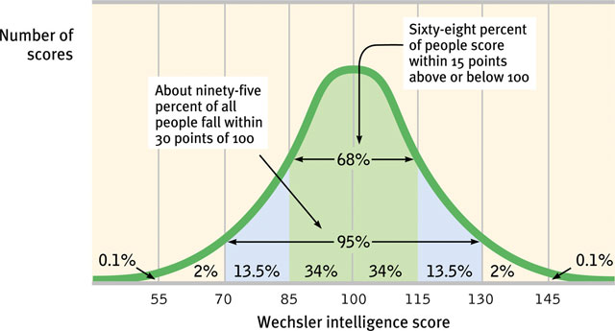
An example of how psychologists apply deviation:
Standardized tests establish a normal distribution of intelligence scores on a tested population in a bell-shaped pattern called the normal curve.

Slide 51
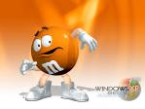
M and Ms lab concepts, 43 and 60
A. sample size: as it increases, the sample becomes more “representative” of the entire population (all the cases in a group, from which samples may be drawn for a study)
Population for this study: every Fun Size pack in the world!

Slide 52
How big of a sample?
For a presidential election about 1,500 randomly chosen can predict the election
….as long as those chosen are “representative” of the voting population

Slide 53
Inferential statistics and Statistical significance, 60
When the observed difference between two groups is NOT due to chance.
There has to be less than 5% probability the difference between the groups under study is due to chance.

Slide 54
12. A researcher determines statistical significance for her study and finds a 5 percent chance that results are due to chance. Which of the following is accurate?
A. this is well beyond the range of statistical significance
B. this is the minimum result typically considered statistically significant
C. this is not statistically significant
D. chance or coincidence is unrelated to statistical significance

Slide 55
13
In a normal distribution, what % falls within one standard deviation on either side of the mean?
A. 95
B. 68
C. 50
D. 40
E. 34

Slide 56
answers
12b
13b

Slide 57
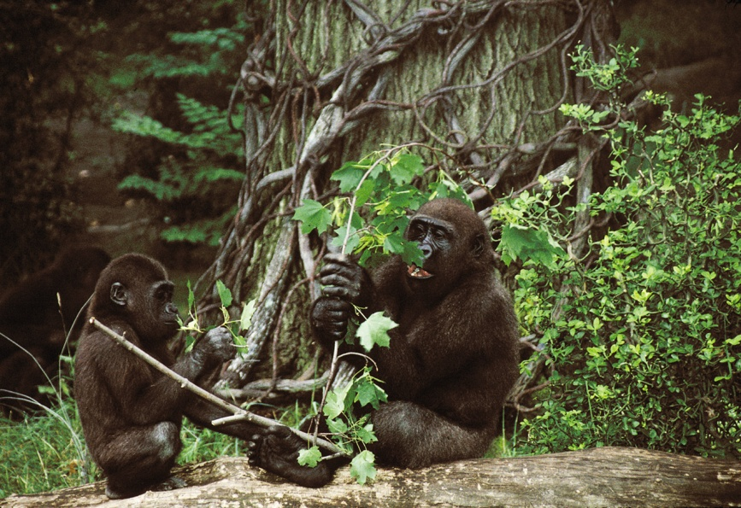
Why do psychologists study animals? 66
Studying animals gives us the understanding of many behaviors that may have common biology across animals and humans.
D. Shapiro, © Wildlife Conservation Society
Notes:
OBJECTIVE 23| Explain why psychologists study animals, and discuss the ethics of experimentation with both animals and humans.

Slide 58
Is it ethical to experiment on animals? 66-67
Yes, says author David Myers
1 To gain insights to devastating and fatal diseases.
2 All researchers who deal with animal research are required to follow ethical guidelines in caring for these animals.

Slide 59
Research ethics guidelines for animals, 67
The British Psychological groups require animals to be housed under natural living conditions with other animals
American guidelines require researchers to ensure the comfort, health and humane treatment of animals in experiments.
Infection, illness and pain should be minimized.

Slide 60
Ethical Guidelines (APA) for human experiments, 68
(Write these down on your hand out)
1. Informed consent.
Participation should be voluntary and based on informed consent: subjects should know what is involved so they can make the decision to participate. Subjects may withdraw at any time.

Slide 61
Ethics: Protection from harm
2. There should be no exposure to harmful procedures.
Researchers should make every effort to ensure that subjects aren’t physically or psychologically harmed by the experiment

Slide 62
Debriefing
3. Any deception must be promptly explained during debriefing.
The deception should be such that it would not have affected the subject’s decision to participate.

Slide 63
Experimental ethics: Privacy
4. The right to privacy shall be maintained.
Subject’s names and experiment results/data shall not be identified.

Slide 64
14.
To fulfill informed consent what should a researcher do?
A. keep information confidential
B. allow participants to choose whether to take part
C. protect subjects from harm
D. provide a post-experiment explanation of the study

Slide 65
15
Which ethical principle requires that at the end of the study subjects should be told about the true purpose?
A. IRB approval
B. informed consent
C. confidentiality
D. debriefing
E. protection from harm

Slide 66
answers
14b
15d

